Slide 2

Subject : Introduction to Deep Learning
Group 6: Face Recognition
Team members:
Vũ Lâm Anh
Hồ Ngọc Ánh
Hoàng Thành Đạt
Trịnh Hoàng Giang
Lăng Văn Quý
20214876
20214877
20214889
20214893
20214928

Slide 3
Outline
Introduction
Dataset
Data Preprocessing
Modelling
Experiment and Result
Conclusion and Future Work
References

Slide 4
Outline
Introduction
Dataset
Data Preprocessing
Modelling
Experiment and Result
Conclusion and Future Work
References

Slide 5
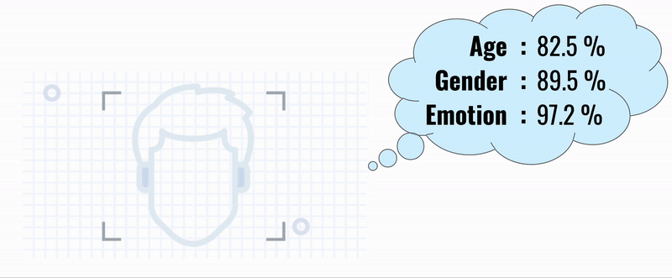
Introduction
Problem Statement:
Developing a Facial analysis system, combining cutting-edge technologies for face detection, age estimation, gender classification, and facial emotion recognition
https://medium.com/@skillcate/age-gender-emotion-detection-using-cnn-in-keras-5aa7172316cf

Slide 6
Outline
Introduction
Dataset
Data Preprocessing
Modelling
Experiment and Result
Conclusion and Future Work
References

Slide 7
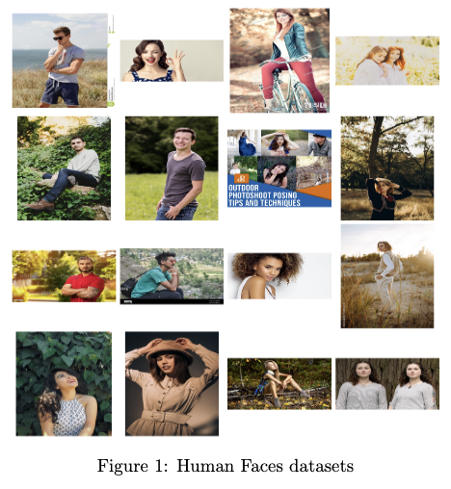
Dataset
Human Faces :
Notes:
In this study, we use 3 datasets, the first is the Human faces dataset, which is a diverse dataset of 2204 photos with 3350 faces.

Slide 8
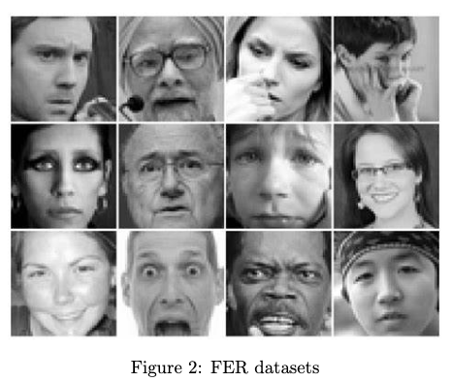
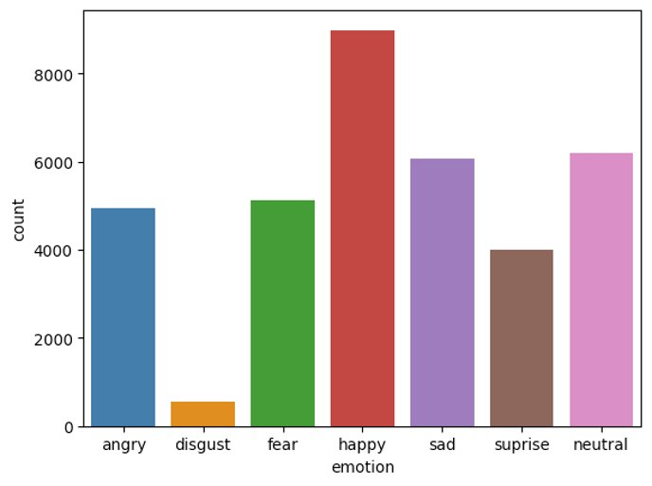
Dataset
FER-2013:

Slide 9
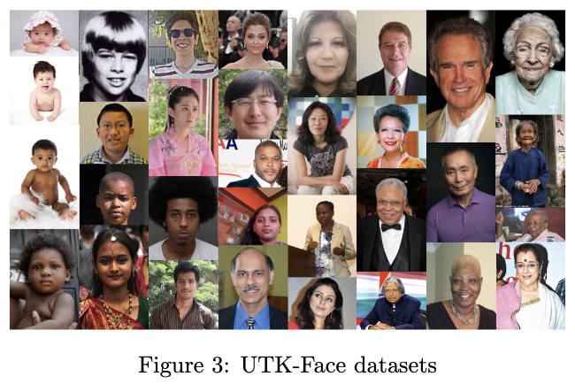
Dataset
UTK-Face:

Slide 10
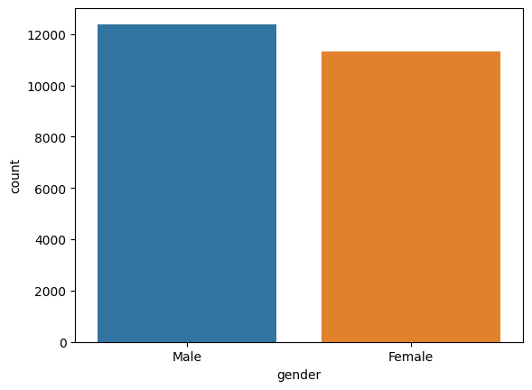
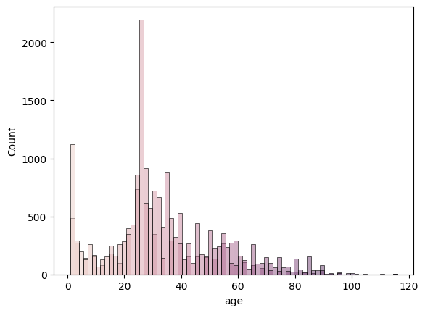
UTK-Face:

Slide 11
Outline
Introduction
Dataset
Data Preprocessing
Modelling
Experiment and Result
Conclusion and Future Work
References

Slide 12
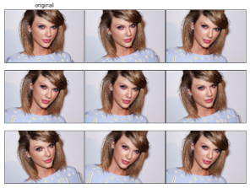
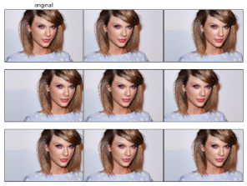
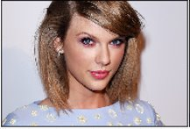
Data Preprocessing
3.1. Age&Gender Recognition
Validation Split: We use 80% data for training and 20% for testing.
Rescaling: Images were rescaled to a range of [0, 1].
Data augmentation method: rotation_range, width_shift_range, shear_range, zoom_range, …etc
For example:
original
Rotation_range = 20
Width_shift_range = 0.25

Slide 13
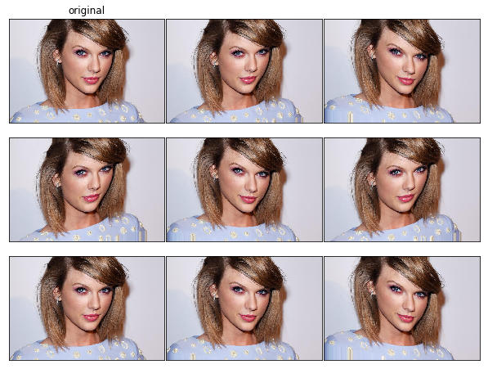
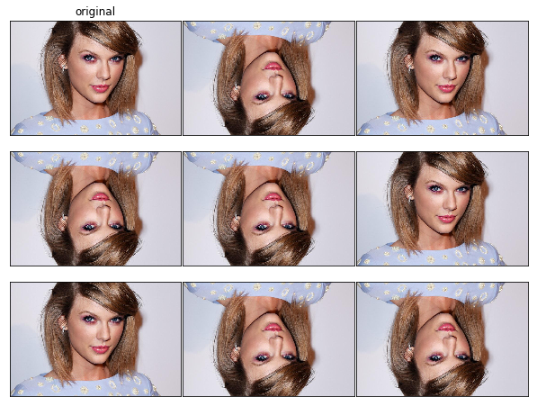
Data Preprocessing
3.1. Age&Gender Recognition
Shear_range = 0.2
Vertical_flip = True

Slide 14
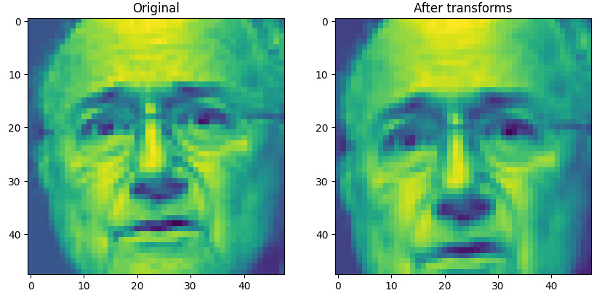
Data Preprocessing
3.2. Facial Emote Recognition
Some techniques we use to improve performance of the models:
RandomResizedCrop: We scale the image in height and width by 0.8 and 1.2 then random crop image and resize back to 48x48.

Slide 15
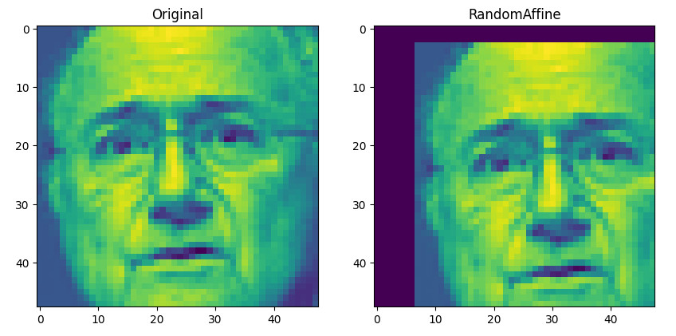
Data Preprocessing
3.2. Facial Emote Recognition
Some techniques we use to improve performance of the models:
RandomAffine: We randomly move the image to right or to the left with length = 0.2 * width, up or down with length = 0.2 * height.

Slide 16
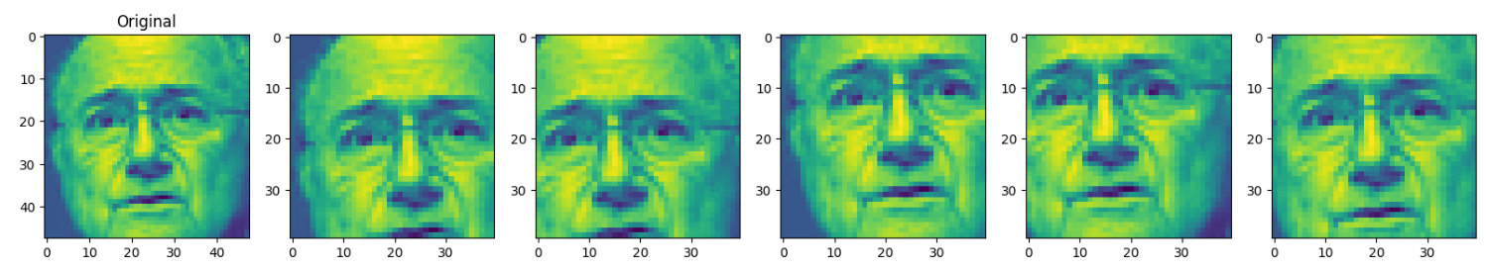
Data Preprocessing
3.2. Facial Emote Recognition
FiveCrop: We randomly crop original image into five images with 40x40 pixels.
Finally, we normalize the image by dividing it by 255.

Slide 17
Outline
Introduction
Dataset
Data Preprocessing
Modelling
Experiment and Result
Conclusion and Future Work
References

Slide 18

Visual Geometry Group(VGG)
VGG is a classical convolutional neural network architecture characterized by its simplicity: series of convolutional layers and max-pooling layers, ending by fully connected layers.
Notes:
The model’s depth, with configurations such as VGG16 and VGG19, contributed to its effectiveness in capturing intricate features within images.

Slide 19
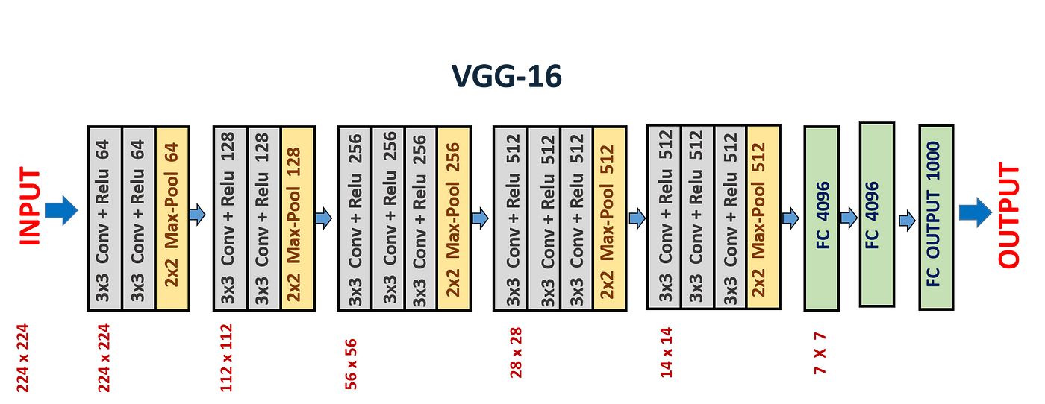
VGG Architecture
VGG16
13 convolutional layers
3 fully connected layers

Slide 20
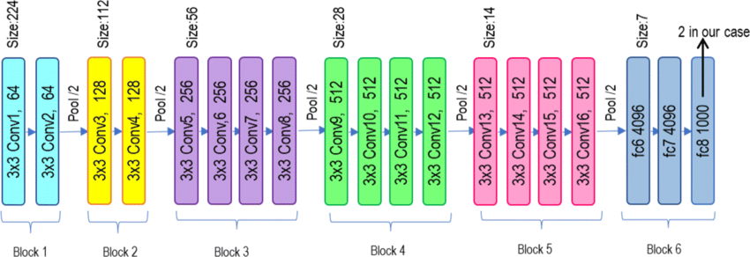
VGG Architecture
VGG19 :
16 convolutional layers
3 fully connected layers

Slide 21
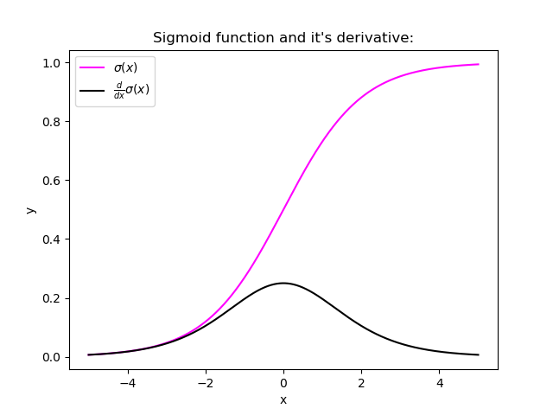
Residual Network(ResNet)
ResNet is a CNN architecture that overcame the vanishing gradient problem, making it possible to construct deeper networks, which outperform shallower networks.
Notes:
The common problem with model in deep learning and also other CNN model like VGG is “vanishing gradient” problem.

Slide 22
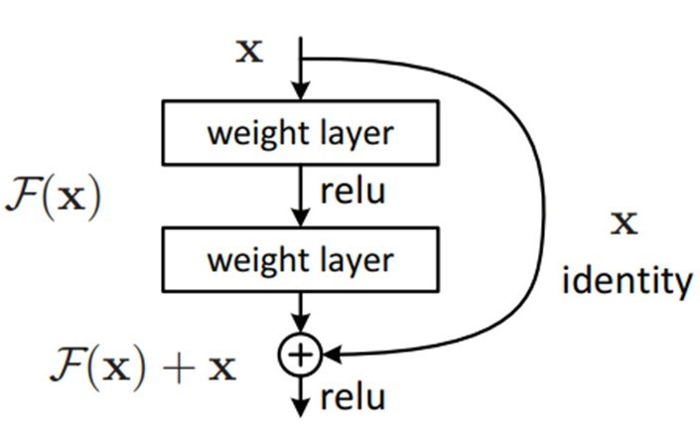
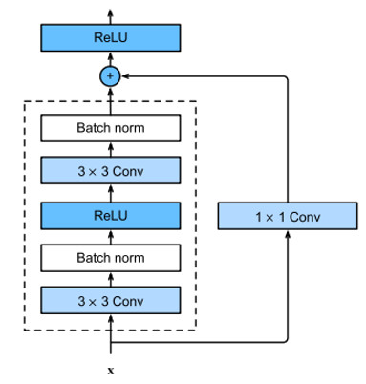
Residual Block
The idea of ResNet is inspired by the technique is called skip connections
These Residual Block help we overcome the gradient vanishing and possible to explore additional parts of the feature space.
Notes:
The skip connection connects activations of a layer to activations of further layers by skipping some layers in between

Slide 23
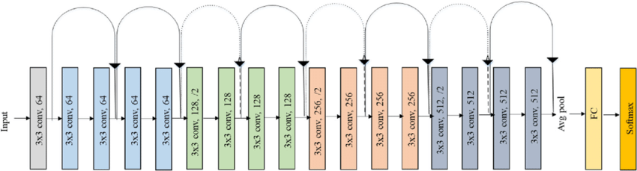
ResNet Architecture
ResNet are made by stacking these residual blocks together.
Notes:
This is an example of ResNet 18

Slide 24
YOLOv5
YOLOv5 is a popular real-time object detection algorithm used in computer vision.
YOLOv5 achieves competitive performance through improvements in the architecture, training techniques, and data augmentation.

Slide 25
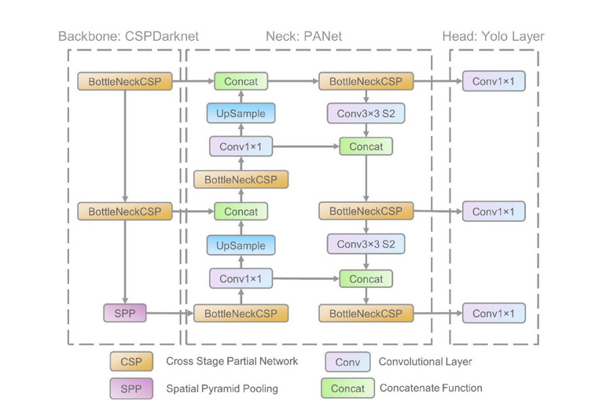
YOLOv5 Architecture
Divided into 3 sections: Backbone, Neck, Head

Slide 26
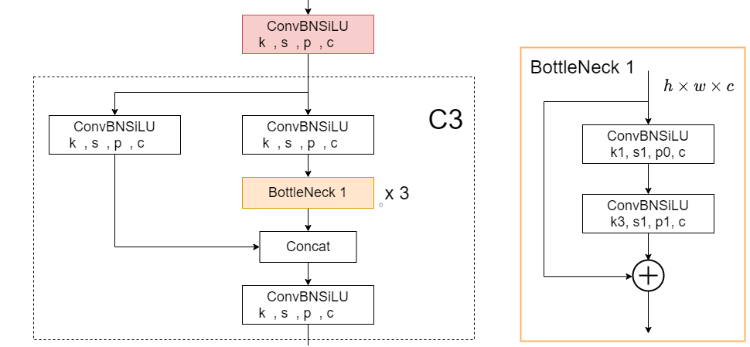
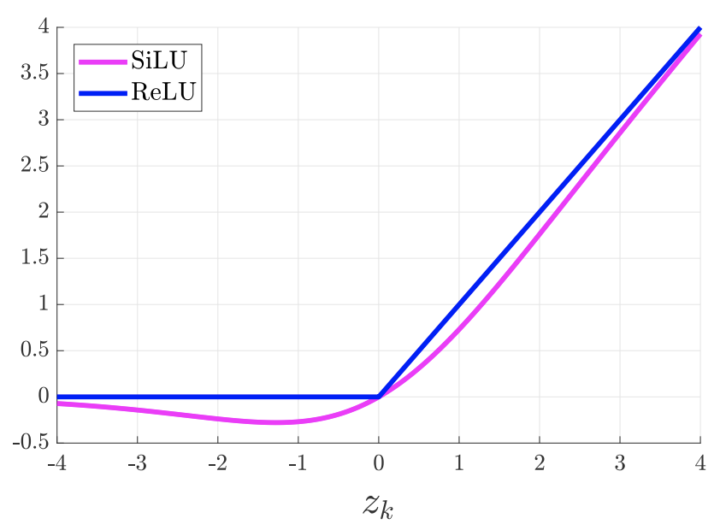
Backbone
The backbone is designed using the CSP-Darknet53 structure
Modified Darknet architecture by using CSPDenseBlock instead of DenseBlock
Notes:
The tensor is divided into 2 parts. The first part goes through a convolutional, batch normalization and SiLU activation function layer; a BottleNeck block and then concats with the second parts after a convolutional layer. The concatenation is passed through a convolutional layer.

Slide 27
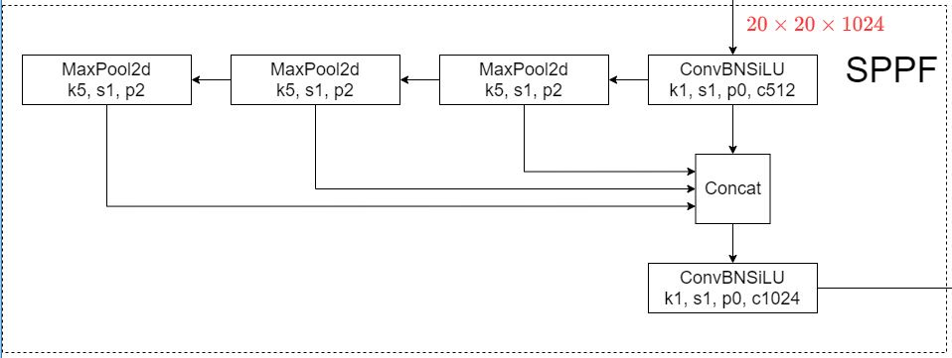
Neck
Used Spatial Pyramid Pooling Fusion(SPPF) and CSP-PAN structure

Slide 28
Head
3 dectection layers:
80 x 80x 256 for detect small size object
40 x 40x 512 for detect medium size object
80 x 80x 512 for detect large size object

Slide 29
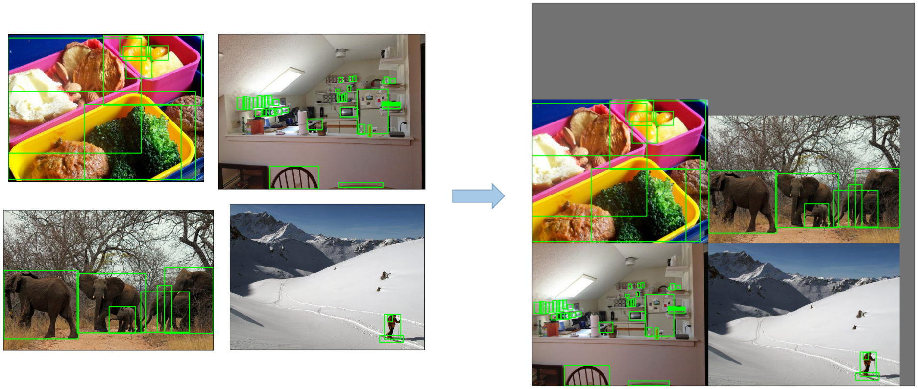
Data Augmentation
Mosaic Augmentation
Notes:
An image processing technique that combines four training images into one in ways that encourage object detection models to better handle various object scales and translations

Slide 30
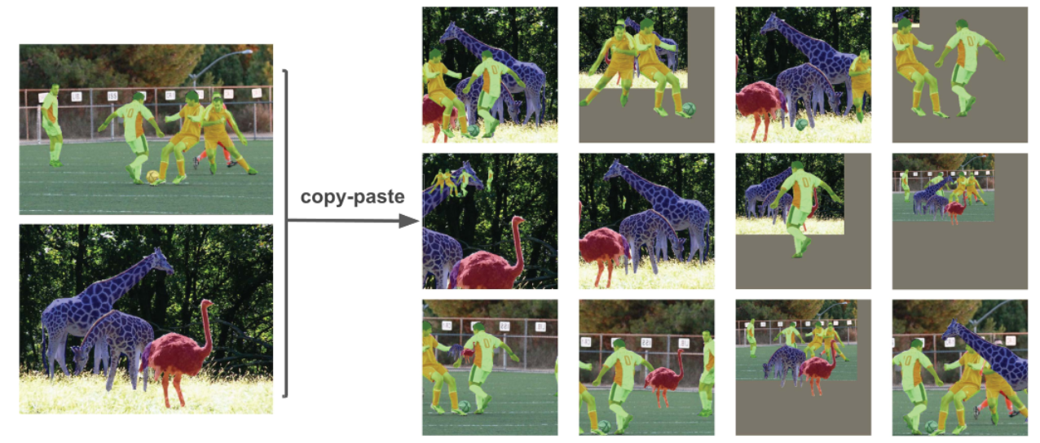
Data Augmentation
Copy-Paste Augmentation
Notes:
An innovative data augmentation method that copies random patches from an image and pastes them onto another randomly chosen image, effectively generating a new training sample

Slide 31
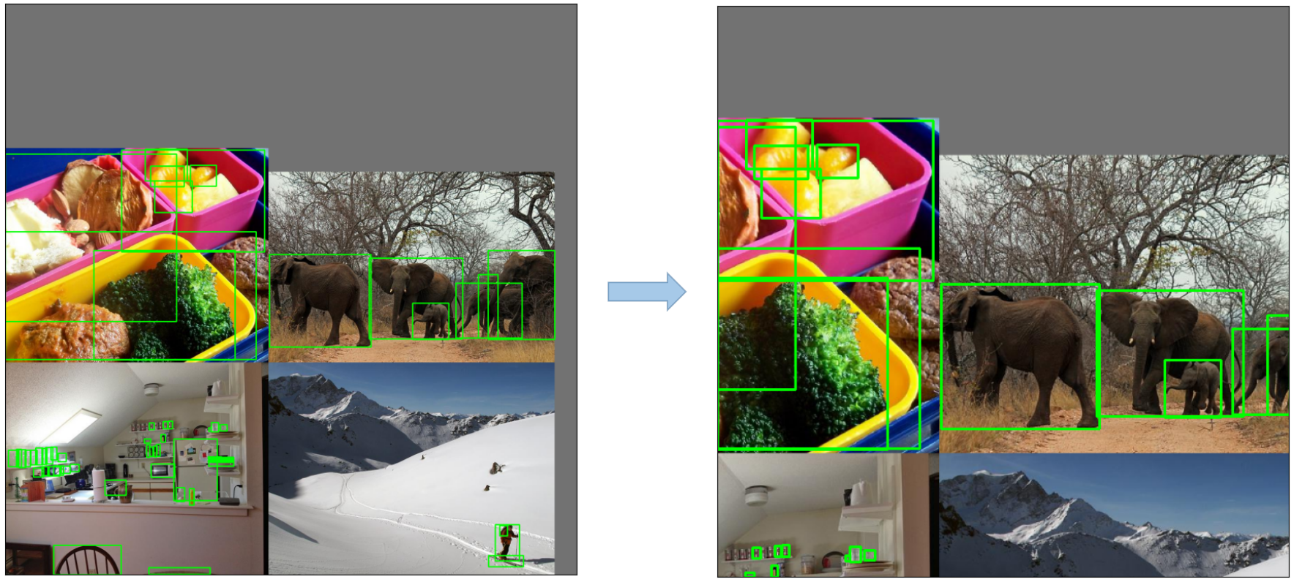
Data Augmentation
Random Affine Transformations

Slide 32
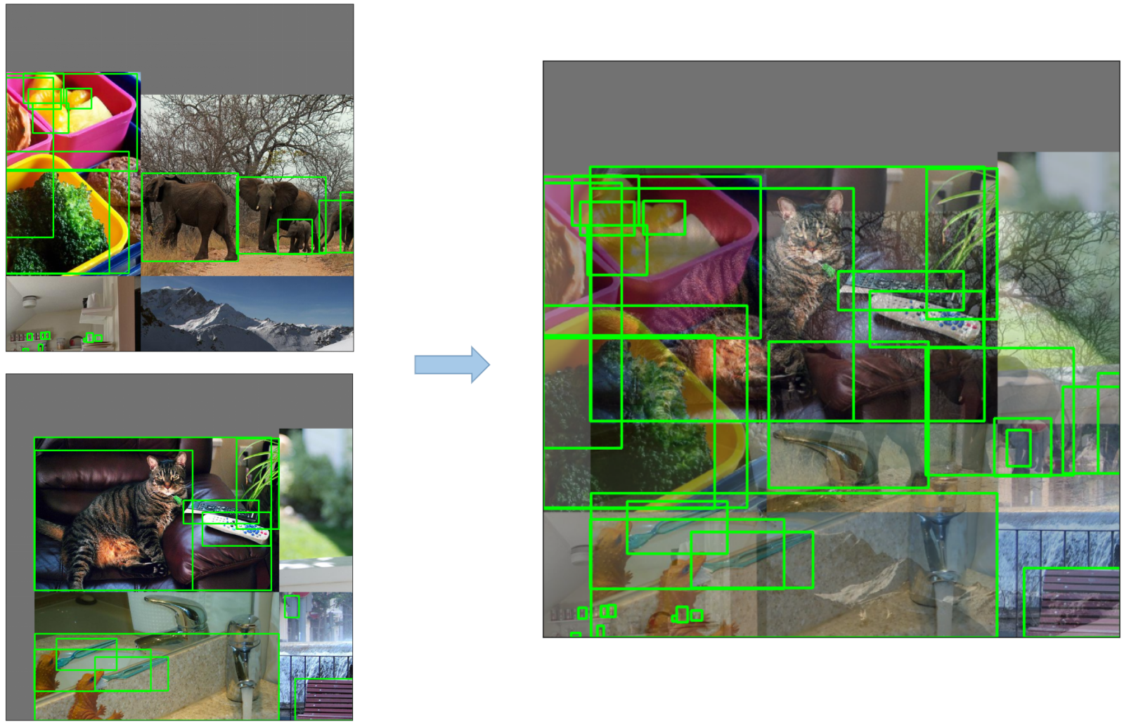
Data Augmentation
MixUp Augmentation
Notes:
method that creates composite images by taking a linear combination of two images and their associated label

Slide 33
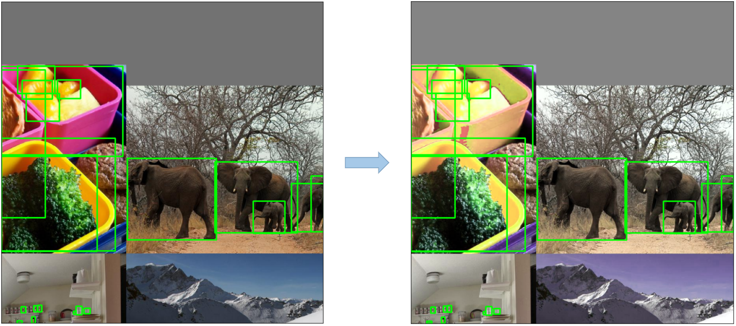
Data Augmentation
HSV Augmentation
Notes:
Random changes to the Hue, Saturation, and Value of the images

Slide 34
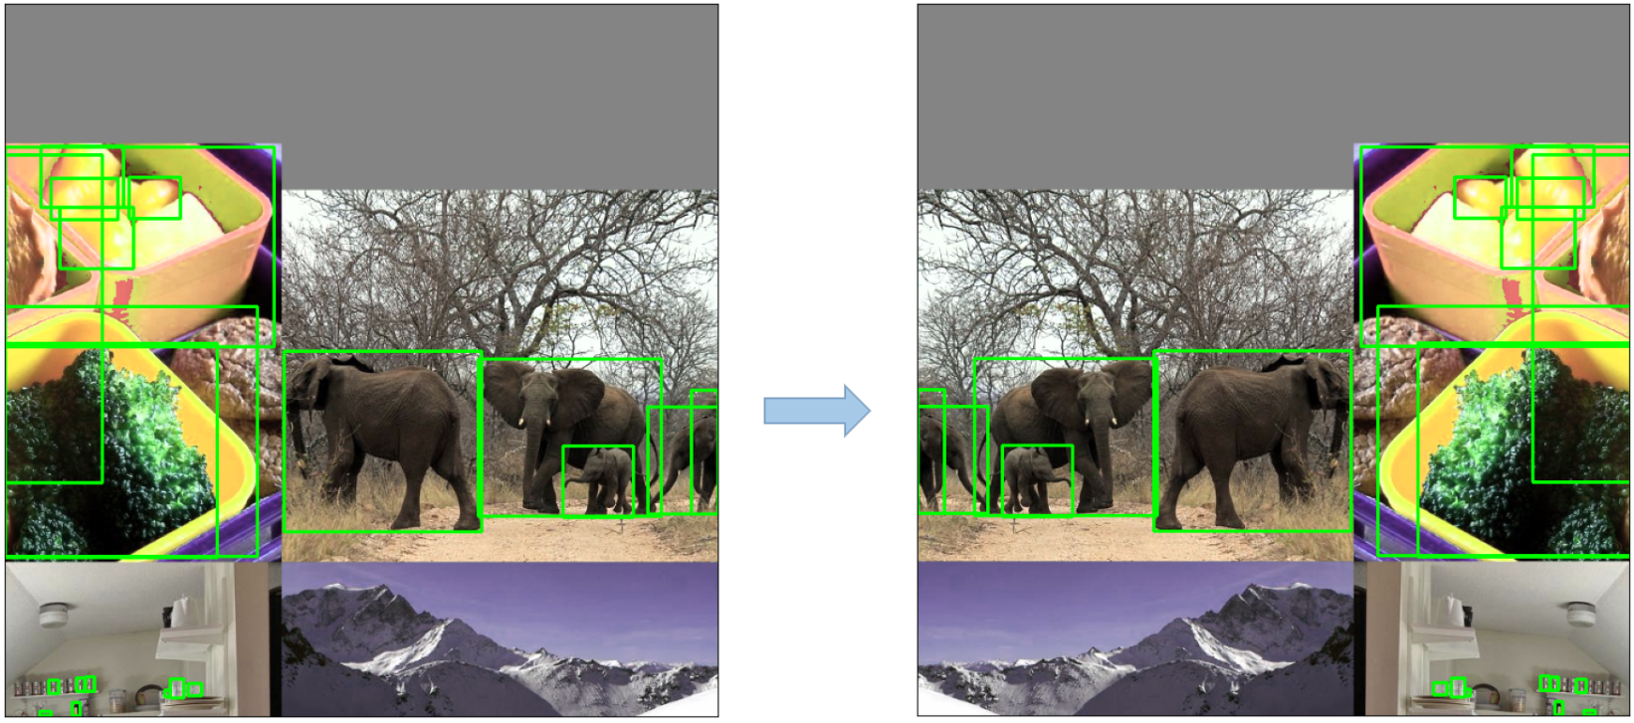
Data Augmentation
Random Horizontal Flip

Slide 35

Data Augmentation
Albumentations: A powerful library for image augmenting that supports a wide variety of augmentation techniques.

Slide 36
Training
Multiscale Training
AutoAnchor
Warmup and Cosine LR Scheduler
Exponential Moving Average (EMA)
Mixed Precision Training
Hyperparameter Evolution
Notes:
YOLOv5 applies several sophisticated training strategies to enhance the model’s performance. They include: • Multiscale Training: The input images are randomly rescaled within a range of 0.5 to 1.5 times their original size during the training process. • AutoAnchor: This strategy optimizes the prior anchor boxes to match the statistical characteristics of the ground truth boxes in your custom data. • Warmup and Cosine LR Scheduler: A method to adjust the learning rate to enhance model performance. • Exponential Moving Average (EMA): A strategy that uses the average of parameters over past steps to stabilize the training process and reduce generalization error. • Mixed Precision Training: A method to perform operations in half-precision format, reducing memory usage and enhancing computational speed.

Slide 37
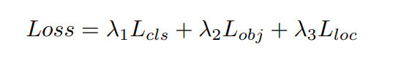
Loss Function
Binary Cross Entropy for classes and objectness losses.
Complete Intersection over Union(CIoU) for location loss.

Slide 38
Outline
Introduction
Dataset
Data Preprocessing
Modelling
Experiment and Result
Conclusion and Future Work
References

Slide 39
Face Detection
IoU=0.5
Confidence Threshold=0.001
Epoch: 100
 | Precision | Recall | mAP50 | mAP50-95
Train | 0.872 | 0.969 | 0.964 | 0.81
Valid | 0.872 | 0.98 | 0.965 | 0.816
Notes:
Choosing IoU=0.5, Confidence Threshold=0.001, after training 100 epochs, we have the performance of YOLOv5 in Face Detection task showed in the below table:
With excellent precision, recall, and mAP scores, the model appears to perform well on both the training and validation sets. The fact that the training and validation sets performed similarly shows that the model did not overfit to the training data. The mAP50 and mAP50-95 scores show that the model is stable across different confidence threshold and IoU ranges.

Slide 40
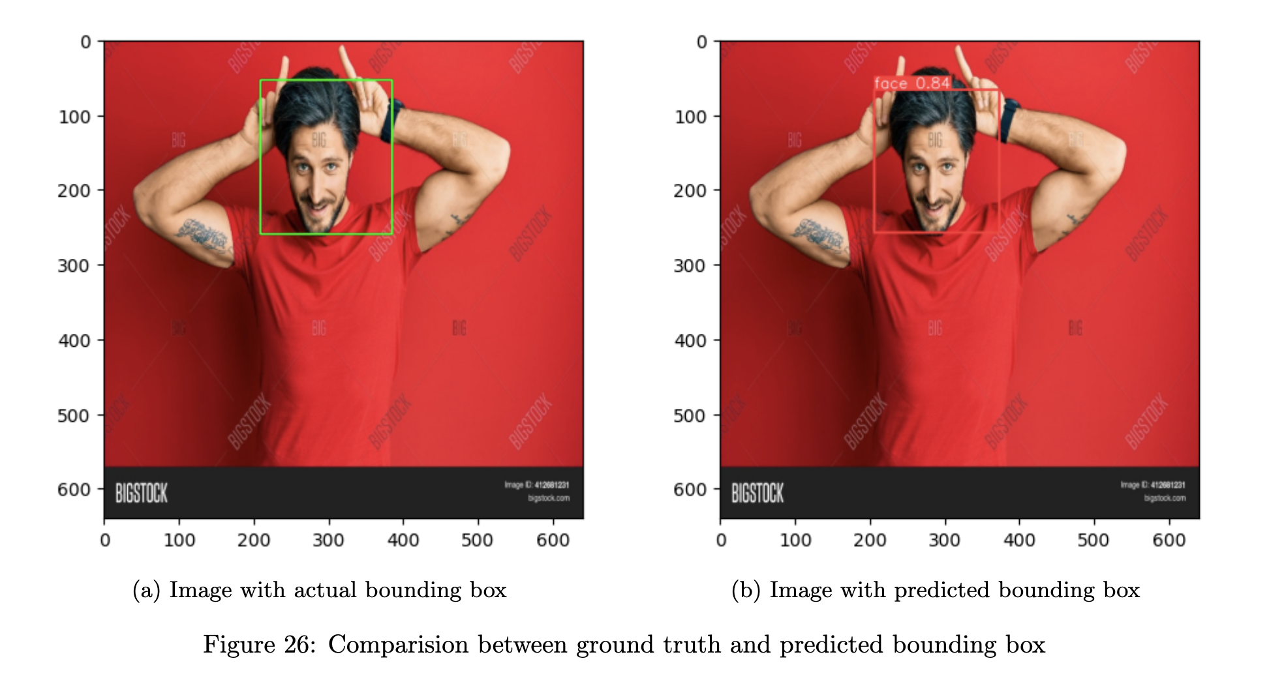
Face Detection

Slide 41
Age Gender Recognition
Loss Function:
MAE for Age
Binary Cross Entropy for Gender
Epoch: 150
Model | Age Prediction | Gender Prediction
ResNet-18 | 7.375 | 0.2114
ResNet-34 | 6.221 | 0.2161
ResNet-50 | 6.681 | 0.2291
ResNet-101 | 7.318 | 0.1939
ResNet-152 | 7.357 | 0.1957
VGG-16 | 8.9967 | 0.4808
VGG-19 | 8.1687 | 0.4208
Notes:
For Age Gender Recognition task we use training configuration as follow:
Based on the findings presented in the aforementioned table, we have concluded that ResNet-34 is the optimal model, striking a favorable balance between validation losses in both Age Prediction and Gender Prediction tasks.

Slide 42
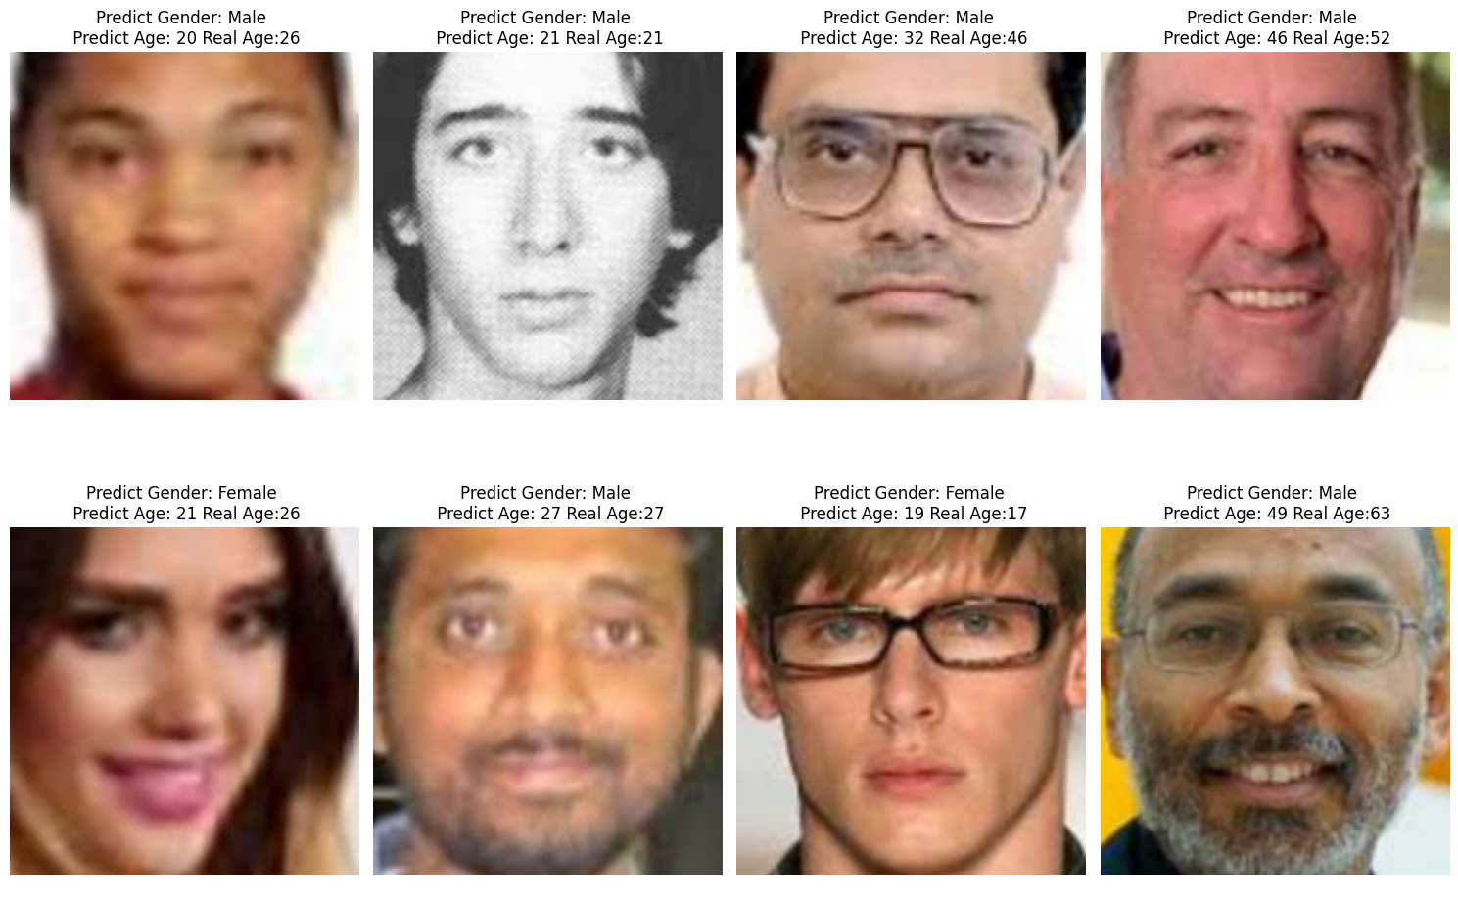
Age Gender Recognition

Slide 43
Facial Emotion Recognition
Loss Function: CrossEntropyLoss
Epoch: 150
Learning rate: 0.001
Scheduler : ReduceLROnPlateau: Reduce learning rate by 0.5 if there are no improvement of validation accuracy after 5 epochs
Model | Test Accuracy (%)
ResNet-18 | 71.25
ResNet-34 | 70.92
ResNet-50 | 70.78
ResNet-101 | 70.85
ResNet-152 | 71.12
VGG-16 | 65.17
VGG-19 | 63.25
Notes:
With this problem, we setup the training configuration as follow:
From the table above, the model ResNet-18 has the best performance. Then we can use it to predict the Facial Emote Recognition.
Here are some example, we try to predict the facial emotion of image in the test datasets:

Slide 44
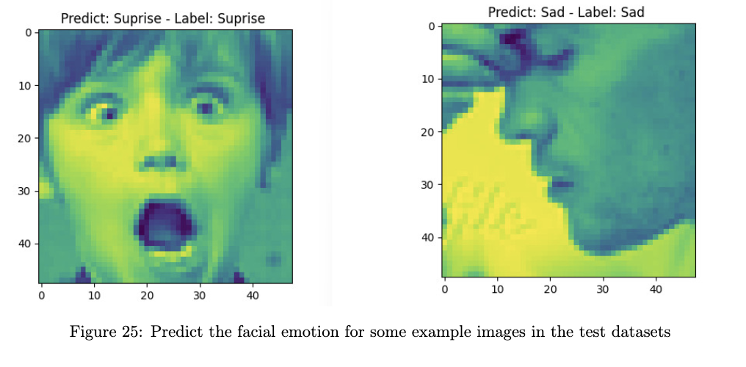
Facial Emotion Recognition

Slide 45
Outline
Introduction
Dataset
Data Preprocessing
Modelling
Experiment and Result
Conclusion and Future Work
References

Slide 46
Conclusion and Future Work
Facial Emotion recognition :
- ResNet-18: the best performances with 71,25% in the test datasets.
-> The model recognized emotions equally or slightly better than humans did ( 65% ±5%).
- Future work: try some stronger model like: Residual Masking Network, PAtt-Lite, EmoNeXt,...
2) Age Gender Recognition :
- ResNet-34 excels in Age and Gender Prediction with a balanced Mean Absolute Error for age and Binary Crossentropy for gender, making it a promising choice for simultaneous recognition tasks.
3) Face Detection Task:
- YOLOv5 excels on both training and validation sets, showcasing high precision, recall, and mAP scores.
- Its consistent performance suggests effective avoidance of overfitting and strong generalization capabilities.

Slide 47
Outline
Introduction
Dataset
Data Preprocessing
Modelling
Experiment and Result
Conclusion and Future Work
References

Slide 48
References
[1] He, Kaiming and Zhang, Xiangyu and Ren, Shaoqing and Sun, Jian (2016): https://arxiv.org/abs/1512.03385v1
[2] Zhang, Aston and Lipton, Zachary C and Li, Mu and Smola, Alexander J (2023): https://d2l.ai/
[3] Ultralytics: https://docs.ultralytics.com/yolov5/tutorials/architecture_description/
[4] Khaireddin, Yousif and Chen, Zhuofa(2021): https://arxiv.org/abs/2105.03588
[5] Human Faces (Object Detection) Dataset Kaggle: https://www.kaggle.com/datasets/sbaghbidi/human-faces-object-detection
[6] FER2013 Datasets Kaggle: https://www.kaggle.com/datasets/ashishpatel26/facial-expression-recognitionferchallenge?rvi=1
[7] UTK-Face Dataset: https://www.kaggle.com/datasets/jangedoo/utkface-new

Slide 49
THANK YOU !

